Slide 1


Day 24
Math24 (Differential Equations)
Ch 3.7 Mechanical and Electrical Vibrations (Page 192-207)
Elementary Differential Equations and Boundary Value Problems, 10th edition, by William E. Boyce and Richard C. DiPrima, ©2013 by John Wiley & Sons, Inc.

Slide 2
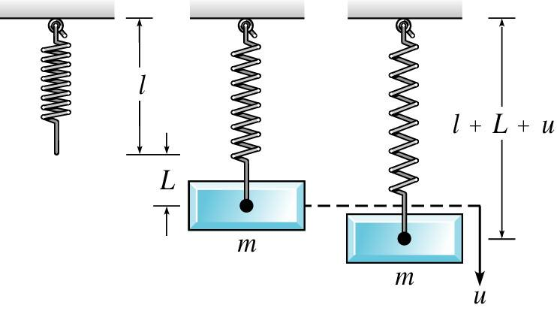
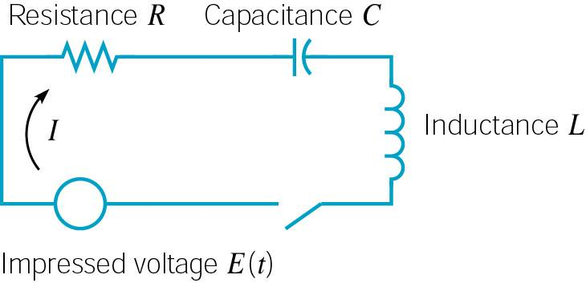
Two important areas of application for second order linear equations with constant coefficients are in modeling mechanical and electrical oscillations.
We will study the motion of a mass on a spring in detail.
An understanding of the behavior of this simple system is the first step in investigation of more complex vibrating systems.

Slide 3

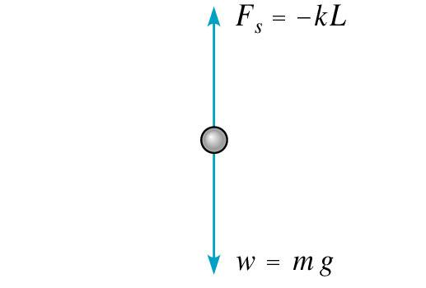
Spring – Mass System
Suppose a mass m hangs from a vertical spring of original length l. The mass causes an elongation L of the spring.
The force F_{G} of gravity pulls the mass down. This force has magnitude mg, where g is acceleration due to gravity.
The force F_{S} of the spring stiffness pulls the mass up. For small elongations L, this force is proportional to L.
That is, F_{s} = kL (Hooke’s Law).
When the mass is in equilibrium, the forces balance each other:

Slide 4

Spring Model
We will study the motion of a mass when it is acted on by an external force (forcing function) and/or is initially displaced.
Let u(t) denote the displacement of the mass from its equilibrium position at time t, measured downward.
Let f be the net force acting on the mass. We will use Newton’s 2nd Law:
In determining f, there are four separate forces to consider:
  Weight: w = mg (downward force)
  Spring force: F_{s} = - k(L+ u) (up or down force, see next slide)
  Damping force: F_{d}(t) = - γ u′ (t) (up or down, see following slide)
  External force: F (t) (up or down force, see text)

Slide 5

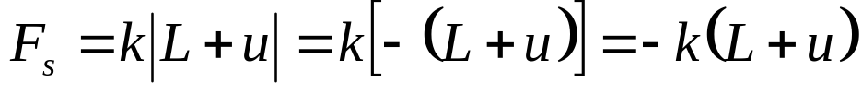
Spring Model:
Spring Force Details
The spring force F_{s} acts to restore a spring to the natural position, and is proportional to L + u. If L + u > 0, then the spring is extended and the spring force acts upward. In this case
If L + u < 0, then spring is compressed a distance of |L + u|, and the spring force acts downward. In this case
In either case,

Slide 6

Spring Model:
Damping Force Details
The damping or resistive force F_{d} acts in the opposite direction as the motion of the mass. This can be complicated to model. F_{d} may be due to air resistance, internal energy dissipation due to action of spring, friction between the mass and guides, or a mechanical device (dashpot) imparting a resistive force to the mass.
We simplify this and assume F_{d} is proportional to the velocity.
In particular, we find that
  If u′ > 0, then u is increasing, so the mass is moving downward. Thus F_{d} acts upward and hence F_{d} = - γ u′, where γ > 0.
  If u′ < 0, then u is decreasing, so the mass is moving upward. Thus F_{d} acts downward and hence F_{d} = - γ u′ , γ > 0.
In either case,

Slide 7
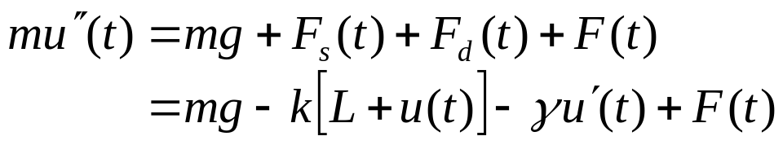


Spring Model:
Differential Equation
Taking into account these forces, Newton’s Law becomes:
Recalling that mg = kL, this equation reduces to
where the constants m, γ, and k are positive.
We can prescribe initial conditions also:
It follows from Theorem 3.2.1 that there is a unique solution to this initial value problem. Physically, if the mass is set in motion with a given initial displacement and velocity, then its position is uniquely determined at all future times.

Slide 8
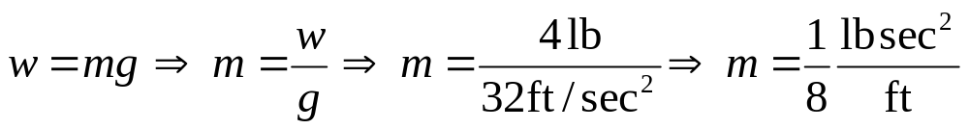
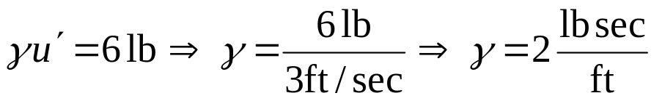
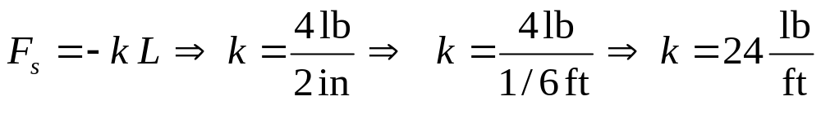
Example 1:
Find Coefficients (1 of 2)
A 4 lb mass stretches a spring 2". The mass is displaced an additional 6" and then released; and is in a medium that exerts a viscous resistance of 6 lb when the mass has a velocity of 3 ft/sec. Formulate the IVP that governs the motion of this mass:
Find m:
Find γ :
Find k:

Slide 9
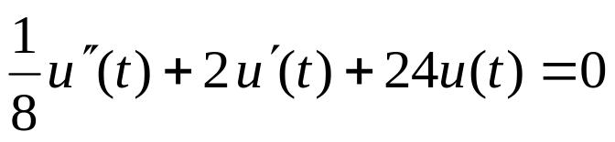
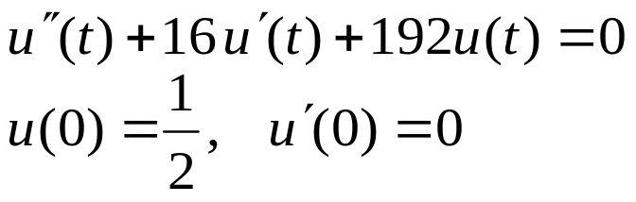
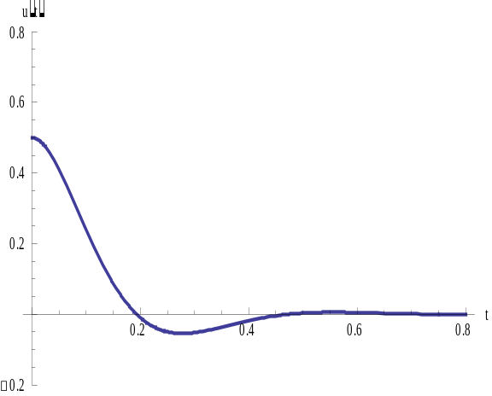

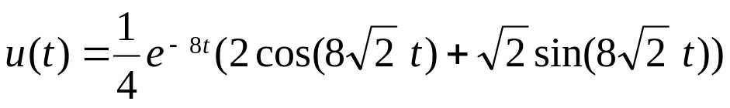
Example 1:
Find IVP (2 of 2)
Thus our differential equation becomes
and hence the initial value problem can be written as
This problem can be solved using the
methods of Chapter 3.3 and yields
the solution

Slide 10


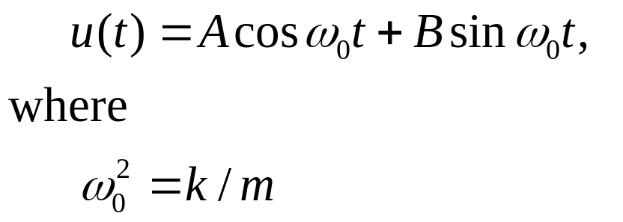
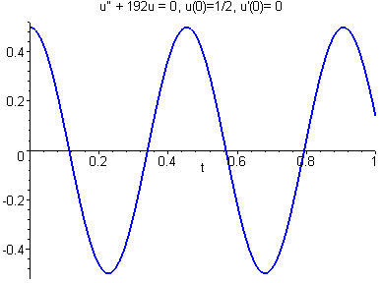
Spring Model:
Undamped Free Vibrations (1 of 4)
Recall our differential equation for spring motion:
Suppose there is no external driving force and no damping. Then F(t) = 0 and γ = 0, and our equation becomes
The general solution to this equation is

Slide 11
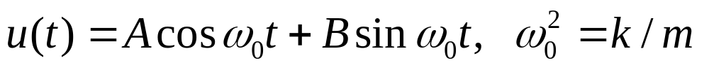
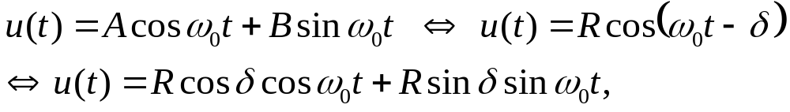
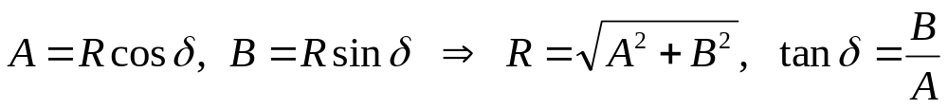
Spring Model:
Undamped Free Vibrations (2 of 4)
Using trigonometric identities, the solution
can be rewritten as follows:
where
Note that in finding δ, we must be careful to choose the correct quadrant. This is done using the signs of cos δ and sin δ.

Slide 12

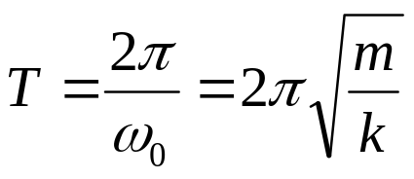
Spring Model:
Undamped Free Vibrations (3 of 4)
Thus our solution is
where
The solution is a shifted cosine (or sine) curve, that describes simple harmonic motion, with period
The circular frequency ω₀ (radians/time) is the natural frequency of the vibration, R is the amplitude of the maximum displacement of mass from equilibrium, and δ is the phase or phase angle (dimensionless).

Slide 13
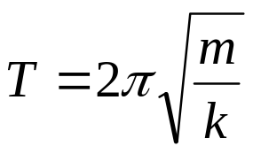
Spring Model:
Undamped Free Vibrations (4 of 4)
Note that our solution
is a shifted cosine (or sine) curve with period
Initial conditions determine A & B, hence also the amplitude R.
The system always vibrates with the same frequency ω₀ , regardless of the initial conditions.
The period T increases as m increases, so larger masses vibrate more slowly. However, T decreases as k increases, so stiffer springs cause a system to vibrate more rapidly.

Slide 14
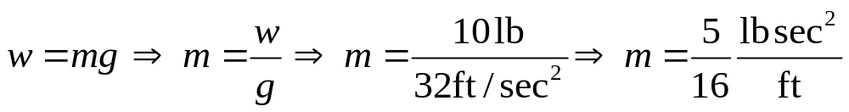
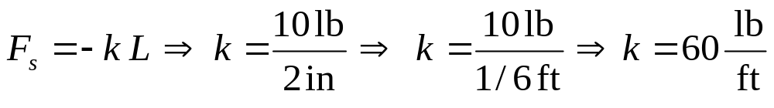
Example 2: Find IVP (1 of 3)
A 10 lb mass stretches a spring 2". The mass is displaced an additional 2" and then set in motion with an initial upward velocity of 1 ft/sec. Determine the position of the mass at any later time, and find the period, amplitude, and phase of the motion.
Find m:
Find k:
Thus our IVP is

Slide 15
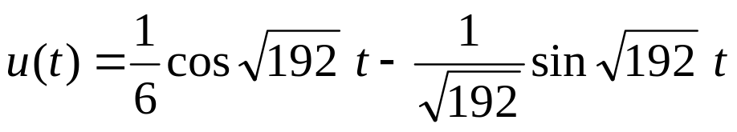
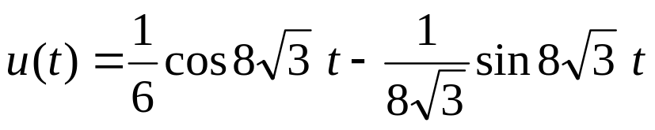
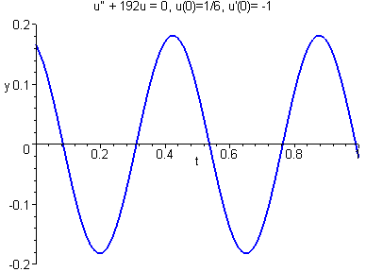
Example 2: Find Solution (2 of 3)
Simplifying, we obtain
To solve, use methods of Ch 3.3 to obtain
or

Slide 16
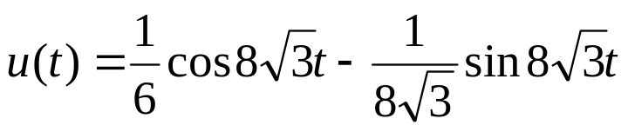
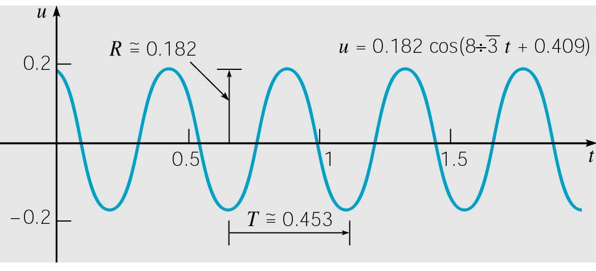


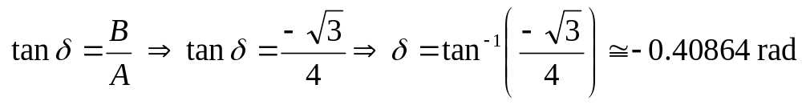

Example 2:
Find Period, Amplitude, Phase (3 of 3)
The natural frequency is
The period is
The amplitude is
Next, determine the phase δ :

Slide 17

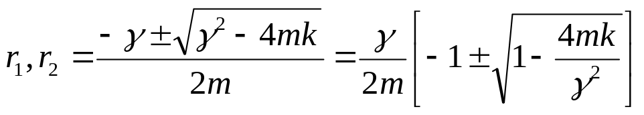
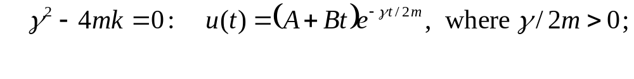
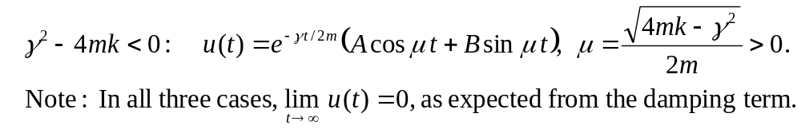
Spring Model: Damped Free Vibrations (1 of 8)
Suppose there is damping but no external driving force F(t):
What is effect of the damping coefficient γ on system?
The characteristic equation is
Three cases for the solution:

Slide 18


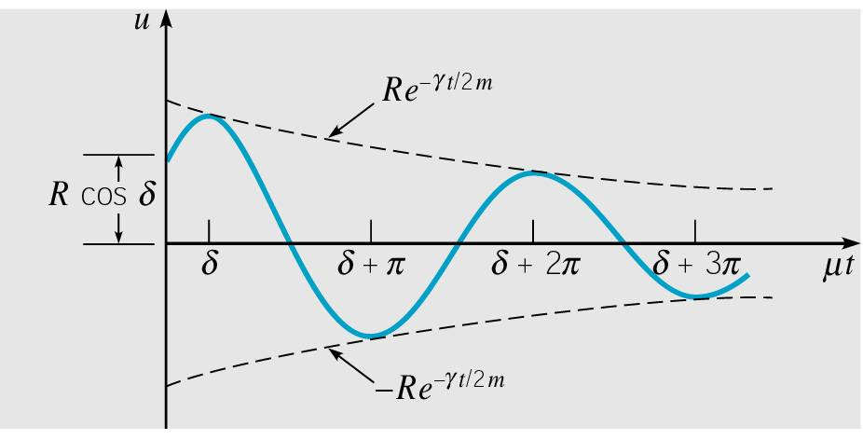
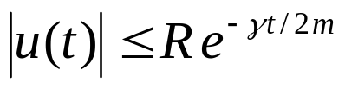
Damped Free Vibrations: Small Damping (2 of 8)
Of the cases for solution form, the last is most important, which occurs when the damping is small:
We examine this last case. Recall
Then
and hence
(damped oscillation)

Slide 19
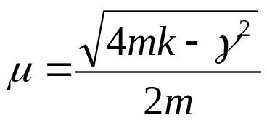
Damped Free Vibrations: Quasi Frequency (3 of 8)
Thus we have damped oscillations:
The amplitude R depends on the initial conditions, since
Although the motion is not periodic, the parameter μ determines the mass oscillation frequency.
Thus μ is called the quasi frequency.
Recall

Slide 20
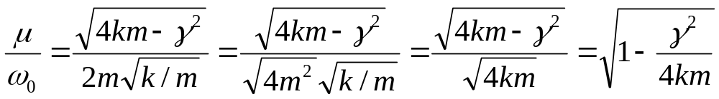
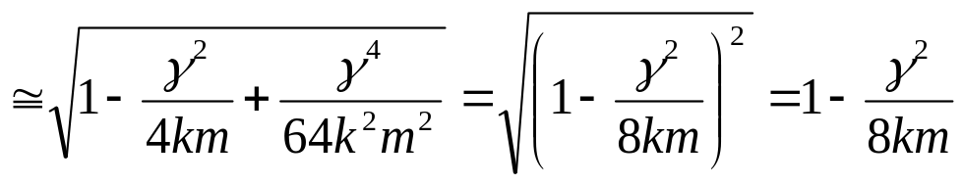
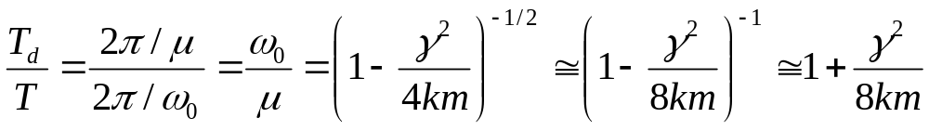
Damped Free Vibrations: Quasi Period (4 of 8)
Compare μ with ω₀ , the frequency of undamped motion:
Thus, small damping reduces oscillation frequency slightly.
Similarly, the quasi period is defined as T_{d} = 2π/μ. Then
Thus, small damping increases quasi period.
For small γ

Slide 21
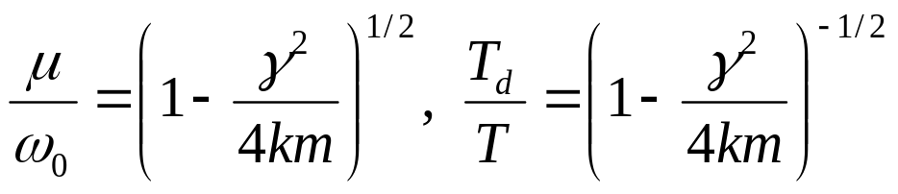
Damped Free Vibrations:
Neglecting Damping for Small γ ²/4km (5 of 8)
Consider again the comparisons between damped and undamped frequency and period:
Thus it turns out that a small γ is not as telling as a small ratio γ ²/4km.
For small γ ²/4km, we can neglect the effect of damping when calculating the quasi frequency and quasi period of motion. But if we want a detailed description of the motion of the mass, then we cannot neglect the damping force, no matter how small it is.

Slide 22
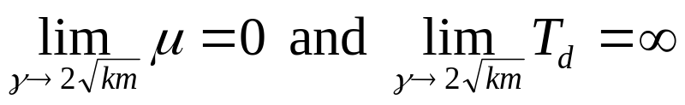
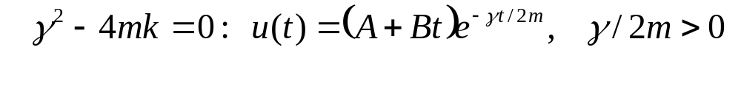
Damped Free Vibrations:
Frequency, Period (6 of 8)
Ratios of damped and undamped frequency, period:
Thus
The importance of the relationship between γ² and 4km is supported by our previous equations:

Slide 23

Damped Free Vibrations:
Critical Damping Value (7 of 8)
Thus the nature of the solution changes as γ passes through the value
This value of γ is known as the critical damping value, and for larger values of γ the motion is said to be overdamped.
Thus for the solutions given by these cases,
we see that the mass creeps back to its equilibrium position for solutions (1) and (2), but does not oscillate about it, as it does for small γ in solution (3).
Soln (1) is overdamped and soln (2) is critically damped.

Slide 24
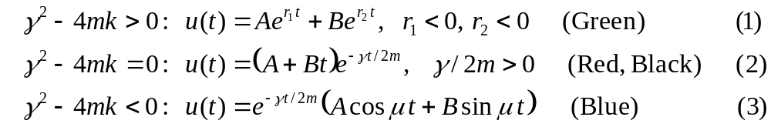
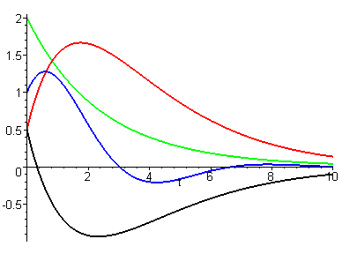
Damped Free Vibrations:
Characterization of Vibration (8 of 8)
The mass creeps back to the equilibrium position for solutions (1) & (2), but does not oscillate about it, as it does for small γ in solution (3).
Solution (1) is overdamped and
Solution (2) is critically damped.
Solution (3) is underdamped

Slide 25
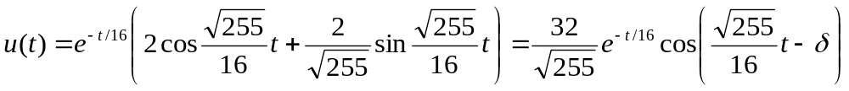
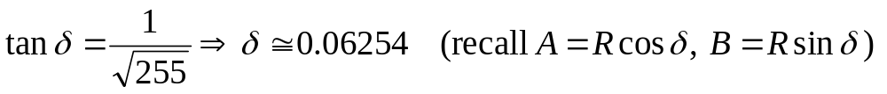
Example 3: Initial Value Problem (1 of 4)
Suppose that the motion of a spring-mass system is governed by the initial value problem
Find the following:
  (a) quasi frequency and quasi period;
  (b) time at which mass passes through equilibrium position;
  (c) time τ such that |u(t)| < 0.1 for all t > τ.
For Part (a), using methods of this chapter we obtain:
where

Slide 26
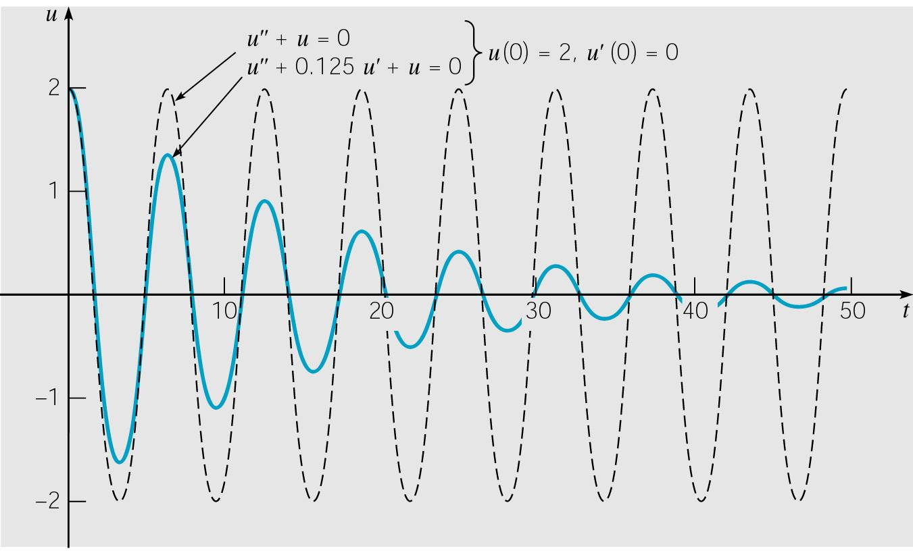



Example 3: Quasi Frequency & Period (2 of 4)
The solution to the initial value problem is:
The graph of this solution, along with solution to the corresponding undamped problem, is given below.
The quasi frequency is
and quasi period is
For the undamped case:

Slide 27

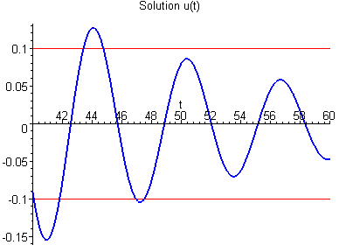
Example 3: Quasi Frequency & Period (3 of 4)
The damping coefficient is γ = 0.125 = 1/8, and this is 1/16 of the critical value
Thus damping is small relative to mass and spring stiffness. Nevertheless the oscillation amplitude diminishes quickly.
Using a solver, we find that |u(t)| < 0.1 for t > τ ≈ 47.515 sec

Slide 28
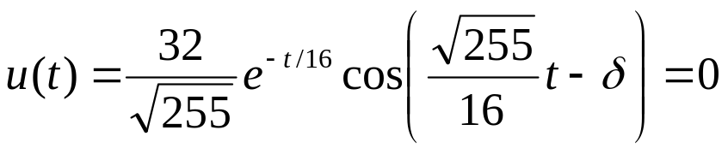
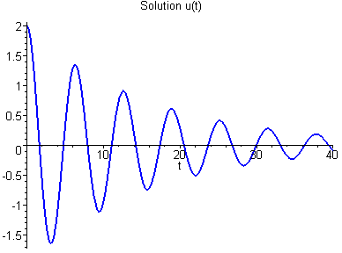
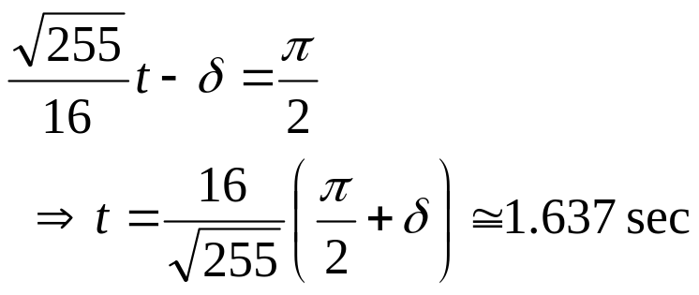
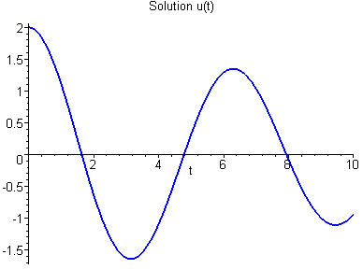
Example 3: Quasi Frequency & Period (4 of 4)
To find the time at which the mass first passes through the equilibrium position, we must solve
Or more simply, solve

Slide 29
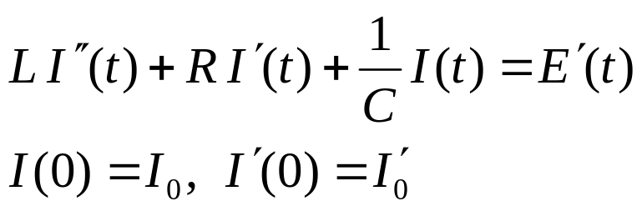
Electric Circuits
The flow of current in certain basic electrical circuits is modeled by second order linear ODEs with constant coefficients:
It is interesting that the flow of current in this circuit is mathematically equivalent to motion of spring-mass system.
For more details, see text.

